Slide 1
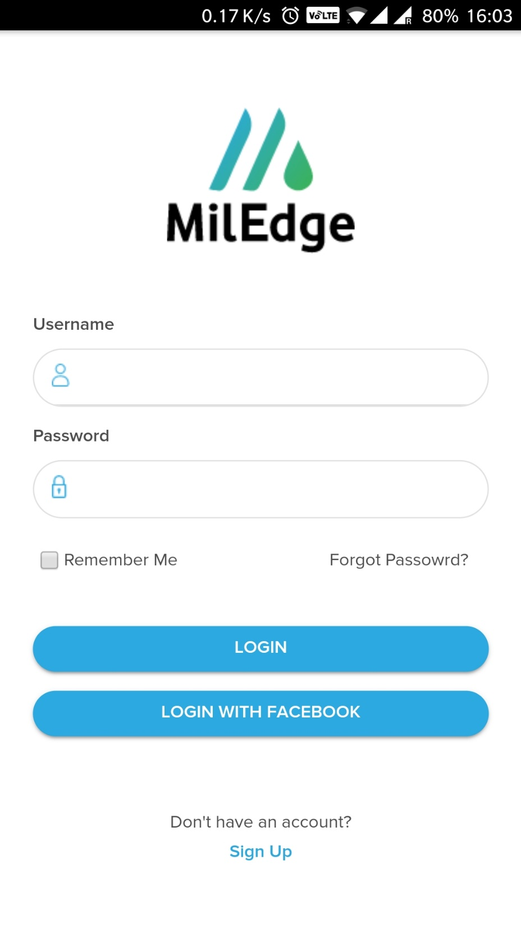
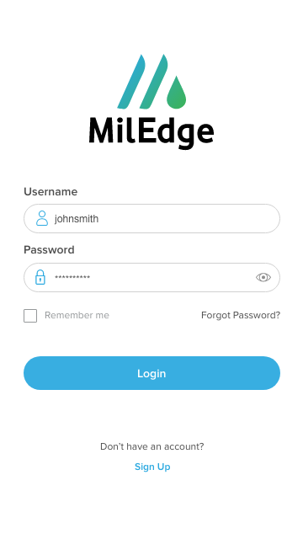
Height 35px
Sentence case

Slide 2
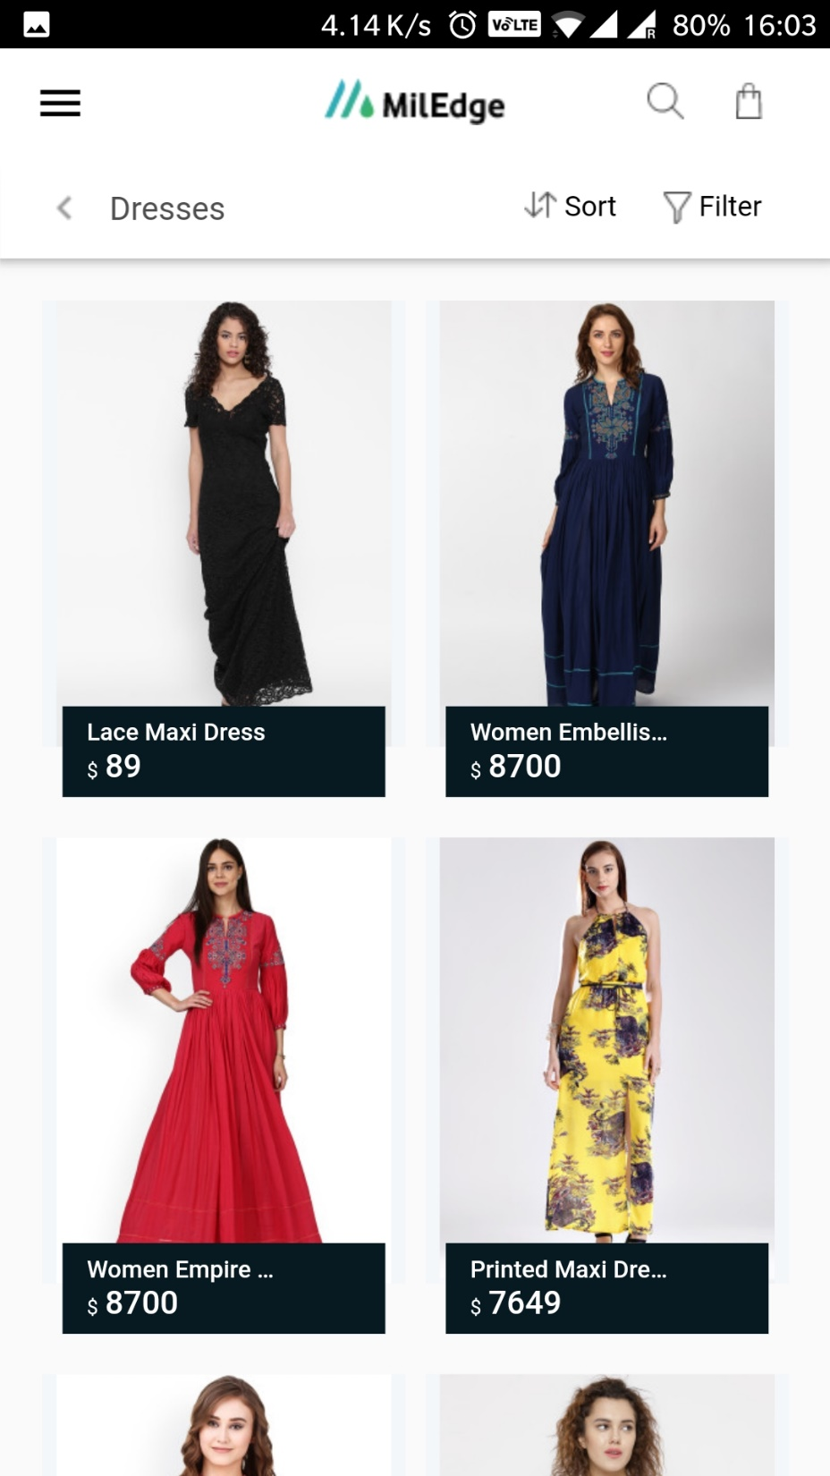
Everything looks good
Keep pricing reasonable

Slide 3
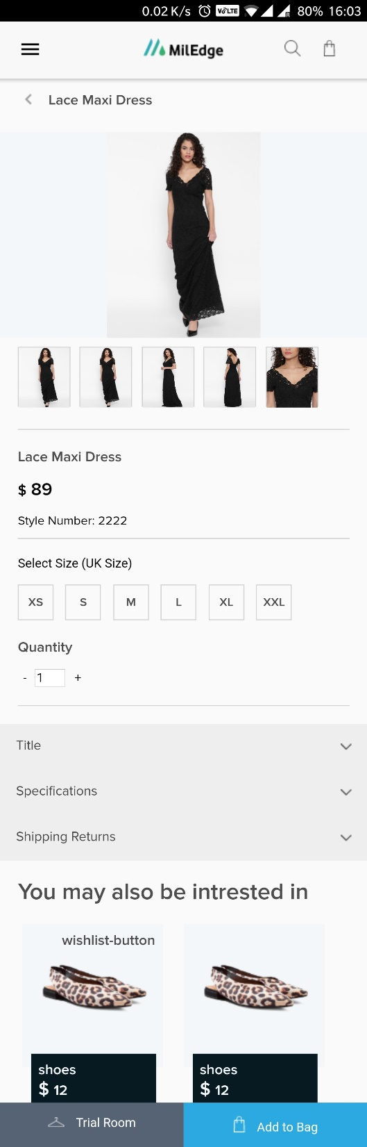
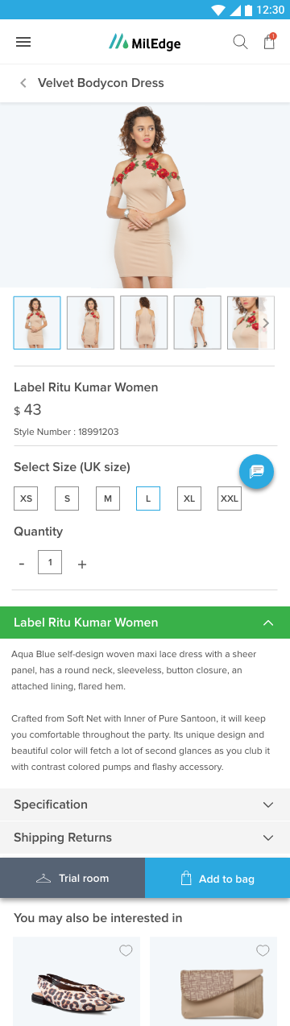
No need of drop shadow
Line color #dedede
Use below values
Bottom stroke missing
Use same font size
Text center align
1px gap
Proximanova semi bold 16px
Size is different

Slide 4
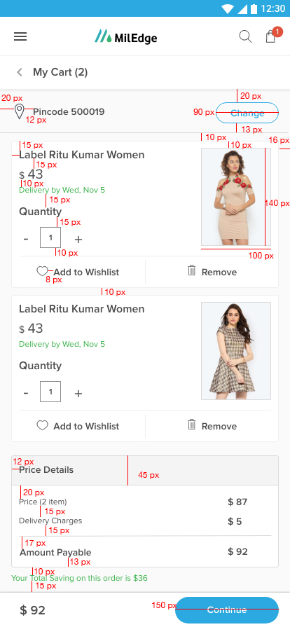
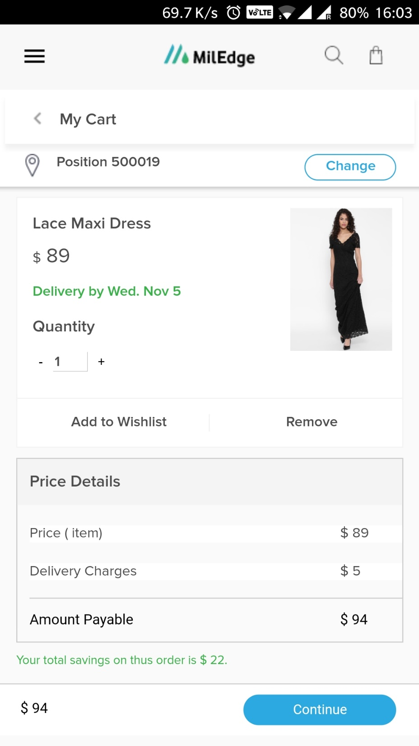
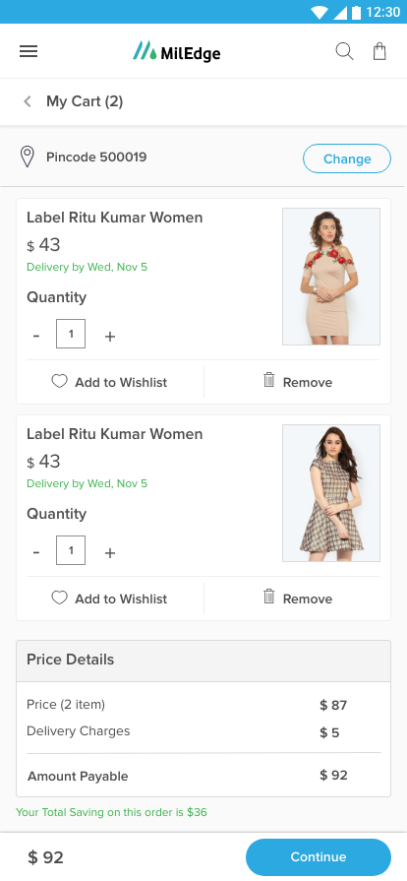
White background
Height 30px
No need of drop shadow
Line color #dedede
Update these values
10px
Missing icons
Rounded Corner 3px
Missing line
Bg color #FFFFFF

Slide 5
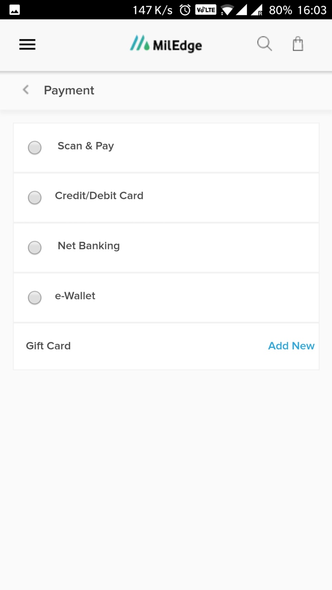
White background
No need of drop shadow
Line color #dedede
10px gap

